Slide 1
TCP/IP Protocol Suite and IP Addressing

Slide 2
Objectives
Introduction to TCP/IP
Internet addresses
Obtaining an IP address

Slide 3
Introduction to TCP/IP

Slide 4
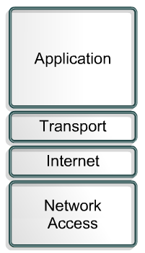
History and Future of TCP/IP
The U.S. Department of Defense (DoD) created the TCP/IP reference model because it wanted a network that could survive any conditions.
Some of the layers in the TCP/IP model have the same name as layers in the OSI model.

Slide 5
Application Layer
Handles high-level protocols, issues of representation, encoding, and dialog control.
The TCP/IP protocol suite combines all application related issues into one layer and ensures this data is properly packaged before passing it on to the next layer.
Can You Name Some Application Layer Examples?

Slide 6
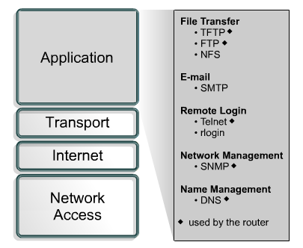
Application Layer Examples

Slide 7
Transport Layer
Five basic services:
Segmenting upper-layer application data
Establishing end-to-end operations
Sending segments from one end host to another end host
Ensuring data reliability
Providing flow control

Slide 8
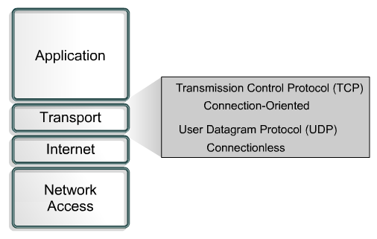
Transport Layer Protocols

Slide 9
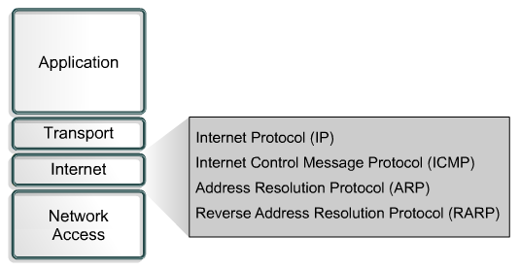
Internet Layer
The purpose of the Internet layer is to send packets from a network node and have them arrive at the destination node independent of the path taken.

Slide 10
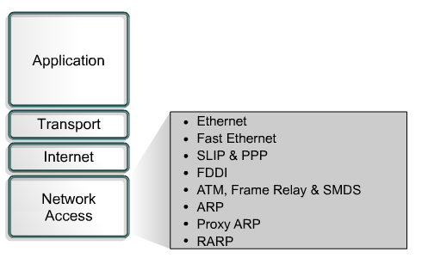
Network Access Layer
The network access layer is concerned with all of the issues that an IP packet requires to actually make a physical link to the network media.
It includes the LAN and WAN technology details, and all the details contained in the OSI physical and data link layers.

Slide 11
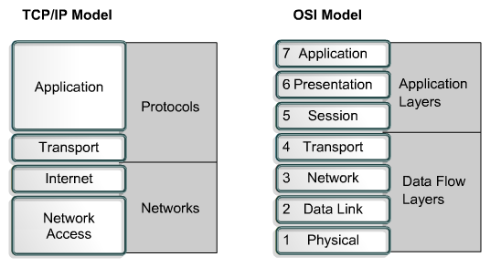
Comparing the OSI Model and TCP/IP Model

Slide 12
Similarities of the OSI and TCP/IP Models
Name some Similarities.
Both have layers.
Both have application layers, though they include very different services.
Both have comparable transport and network layers.
Both are Packet-switched, not circuit-switched.
Networking professionals need to know both models.

Slide 13
Differences of the OSI and TCP/IP Models
TCP/IP combines the presentation and session layer into its application layer.
TCP/IP combines the OSI data link and physical layers into one layer.
TCP/IP appears simpler because it has fewer layers.
TCP/IP transport layer using UDP does not always guarantee reliable delivery of packets as the transport layer in the OSI model does.

Slide 14
Internet Architecture
Two computers, anywhere in the world, following certain hardware, software, protocol specifications, can communicate, reliably even when not directly connected.
LANs are no longer scalable beyond a certain number of stations or geographic separation.

Slide 15
Internet Addresses

Slide 16
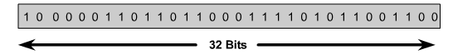

IP Addressing
An IP address is a 32-bit sequence of 1s and 0s.
To make the IP address easier to use, the address is usually written as four decimal numbers separated by periods.
This way of writing the address is called the dotted decimal format.

Slide 17

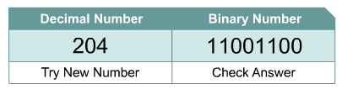
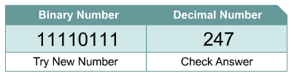
Decimal and Binary Conversion

Slide 18
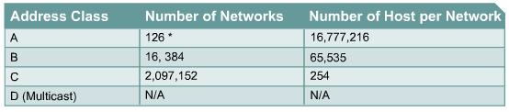
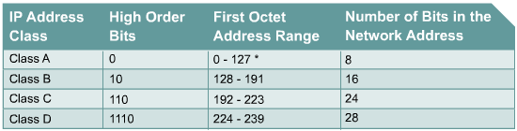

IPv4 Addressing

Slide 19
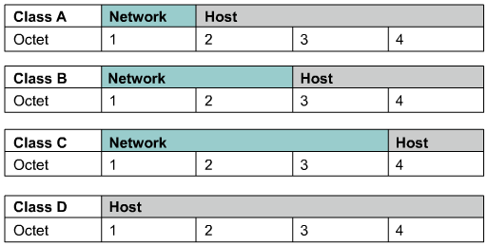
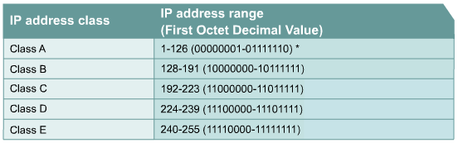

Class A, B, C, D, and E IP Addresses

Slide 20
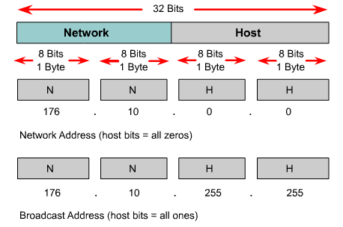
Reserved IP Addresses
Certain host addresses are reserved and cannot be assigned to devices on a network.
An IP address that has binary 0s in all host bit positions is reserved for the network address.
An IP address that has binary 1s in all host bit positions is reserved for the network broadcast address.

Slide 21
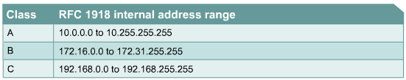
Public and Private IP Addresses
No two machines that connect to a public network can have the same IP address because public IP addresses are global and standardized.
However, private networks that are not connected to the Internet may use any host addresses, as long as each host within the private network is unique.
RFC 1918 sets aside three blocks of IP addresses for private, internal use.
Connecting a network using private addresses to the Internet requires translation of the private addresses to public addresses using Network Address Translation (NAT).

Slide 22
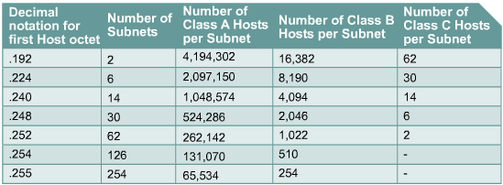
Introduction to Subnetting
To create a subnet address, a network administrator borrows bits from the host field and designates them as the subnet field.

Slide 23
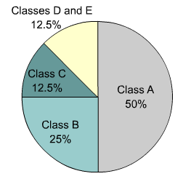
IPv4 versus IPv6
IP version 6 (IPv6) has been defined and developed.
IPv6 uses 128 bits rather than the 32 bits currently used in IPv4.
IPv6 uses hexadecimal numbers to represent the 128 bits.
IPv4

Slide 24
Obtaining an IP Address

Slide 25
Obtaining an Internet Address
Static addressing
  Each individual device must be configured with an IP address Manually.
Dynamic addressing
  Reverse Address Resolution Protocol (RARP)
  Bootstrap Protocol (BOOTP)
  Dynamic Host Configuration Protocol (DHCP) Most Commonly Used
  Function of the Address Resolution Protocol
  ARP operation within a subnet

Slide 26
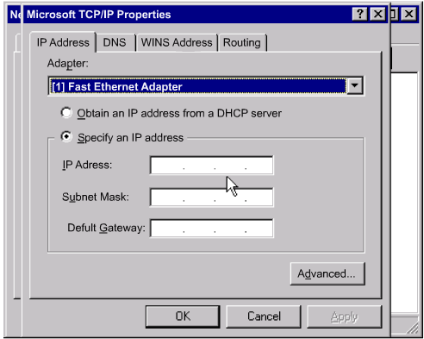
Static Assignment of IP Addresses
Each individual device must be configured with an IP address.

Slide 27
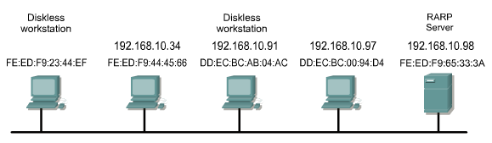
Reverse Address Resolution Protocol (RARP)
MAC HEADER | IP HEADER | RARP REQUEST MESSAGE
Destination FF-FF-FF-FF-FF-FF Source FE:ED:FD:23:44:EF | Destination 255.255.255.255 Source ???????? | What is my IP address?

Slide 28
BOOTP IP
The Bootstrap Protocol (BOOTP) operates in a client/server environment and only requires a single packet exchange to obtain IP information.
BOOTP packets can include the IP address, as well as the address of a router, the address of a server, and vendor-specific information.

Slide 29
Dynamic Host Configuration Protocol
Allows a host to obtain an IP address using a defined range of IP addresses on a DHCP server.
As hosts come online, they contact the DHCP server, and request an address.

Slide 30
Problems in Address Resolution
In TCP/IP communications, a datagram on a local-area network must contain both a destination MAC address and a destination IP address.
There needs to be a way to automatically map IP to MAC addresses.
The TCP/IP suite has a protocol, called Address Resolution Protocol (ARP), which can automatically obtain MAC addresses for local transmission.
TCP/IP has a variation on ARP called Proxy ARP that will provide the MAC address of an intermediate device for transmission outside the LAN to another network segment.

Slide 31
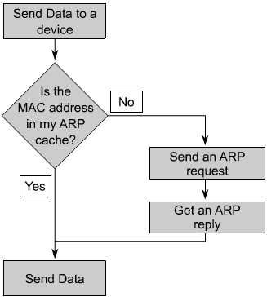
Address Resolution Protocol (ARP)
Each device on a network maintains its own ARP table.
A device that requires an IP and MAC address pair broadcasts an ARP request.
If one of the local devices matches the IP address of the request, it sends back an ARP reply that contains its IP-MAC pair.
If the request is for a different IP network, a router performs a proxy ARP.
The router sends an ARP response with the MAC address of the interface on which the request was received, to the requesting host.

Slide 32
Summary:
The Layers Of The TCP/IP Model
Similarities Between TCP/IP & OSI
Decimal to Binary Conversions
Classes of IP Addresses
Network Address Translation (NAT) & Address Resolution Protocol (ARP)

